Slide 1


CRM-Based Analysis of B2B Hardware Sales
MYSQL PROJECT BY SAYAN MUKHERJEE

Slide 2
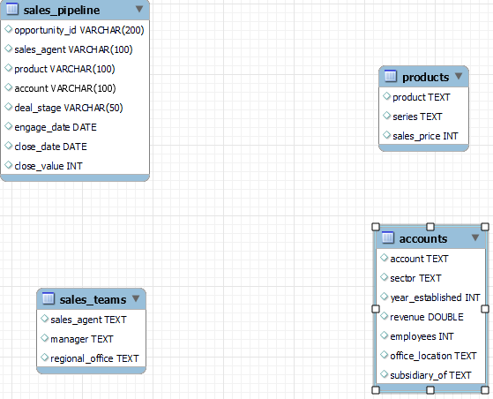
INTRODUCTION:
In this project, the goal is to understand how sales agents manage deals and to uncover insights into sales performance, revenue generation, deal success rates, and sales cycle duration.
The dataset consists of CRM data (sales_pipeline), product information (products), account details (accounts), and sales team structure (sales_teams).

Slide 3
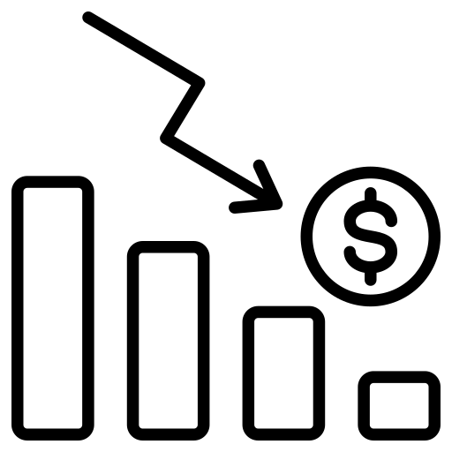
OBJECTIVE OF THE PROJECT:
In order to analyze the overall sales performance through the evaluation of product-wise and sector wise revenue contribution, the effectiveness of deal conversions and the sales cycle duration provided business-wise insights.

Slide 4
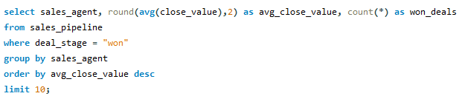
1.Which sales agent has achieved the highest average close value across all 'Won' deals ?
sales_agent | avg_close_value | won_deals
Rosalina Dieter | 4080.97 | 39
Elease Gluck | 3829.82 | 39
Daniell Hammack | 3455.75 | 60
Rosie Papadopoulos | 3132.92 | 36
Markita Hansen | 3132.87 | 68
Zane Levy | 3094.78 | 76
Darcel Schlecht | 3078.35 | 166
James Ascencio | 3023.44 | 64
Wilburn Farren | 2947 | 24
Cassey Cress | 2857.55 | 84
INSIGHTS:
Rosalina Dieter has the highest average close value (4,080.97).
Darcel Schlecht closed the most deals (166).
High-value closers usually have fewer deals.

Slide 5
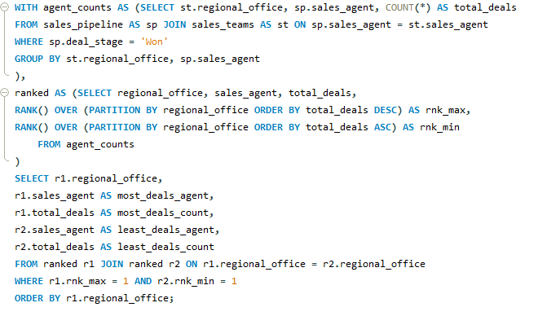
2. Which agent has made the most and the least product deals in each region ?
INSIGHTS:
Darcel Schlecht (Central) closed the most deals overall (166).
Wilburn Farren (East) had the fewest deals (24).
Central region shows the biggest gap between top and bottom performers.

Slide 6
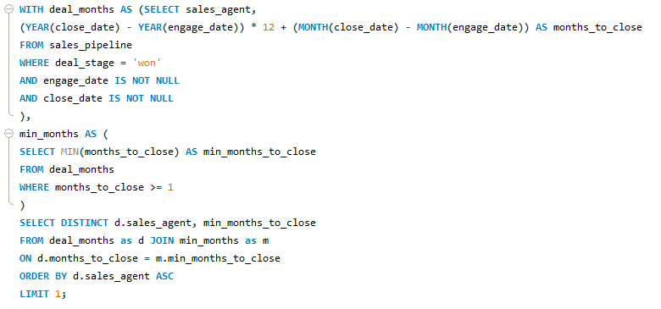
3. Which agent is taking minimum time (In Month) to closing a deal?
sales_agent | min_months_to_close
Anna Snelling | 1
INSIGHTS:
Anna Snelling is the fastest closer, taking only 1 month to close a deal.

Slide 7
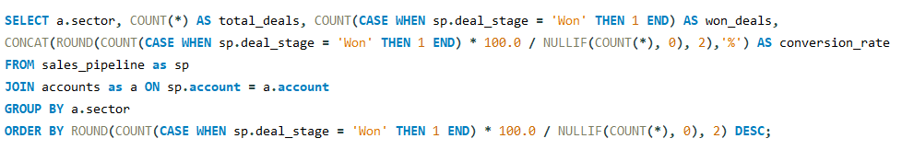
4. Sector wise conversation rate?
INSIGHTS:
Entertainment leads with the highest conversion rate (69.57%).
Employment has the lowest conversion rate (62.07%).
Overall, most sectors maintain strong conversion rates above 65%.
Ask ChatGPT

Slide 8
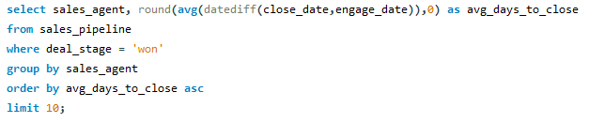
5. What is the average time (in days) taken to close a deal by an agent ?
INSIGHTS:
Cecily Lampkin, Daniell Hammack, and Zane Levy average 53 days to close a deal.
Moses Frase and Lajuana Vencill take the longest, averaging 77 days.
There is a 24-day gap between the fastest and slowest average closing times,
highlighting significant differences in efficiency among agents.
Ask ChatGPT

Slide 9
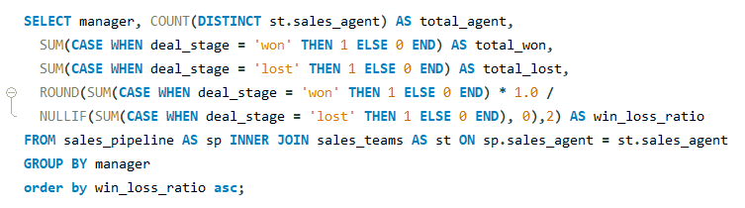
6. what is the win to loss ratio by manager ?
INSIGHTS:
Cara Losch leads with 2.14, indicating strong deal success.
Melvin Marxen has the lowest at 1.85, though still positive.
All managers maintain a win/loss ratio above 1.8, reflecting overall effective performance across the team.

Slide 10
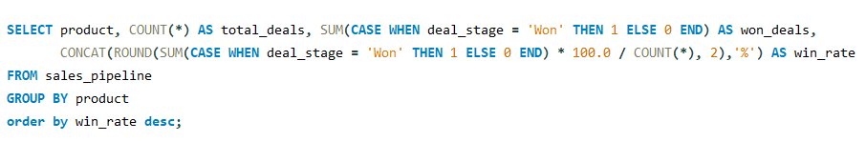
7. what is the win rate based on the product ?
INSIGHTS:
GTK 500 has the highest win rate (73.33%), indicating strong market performance.
MG Advanced is lowest at 63.19%.
Most products have a win rate above 65%, showing generally good sales effectiveness.

Slide 11
RECOMMENDATION:
In order to increase efficiency among slower closers, one can exchange the best practices used by the top performers.
Provide targeted coaching for agents that always have very low close values so you can get quality deals.
Study the large disparity in performance in some areas and standardize sales approaches to get more uniform results.
Target low conversion areas in a more precise manner and update the messaging strategies.
Keep on pushing the products that have good win rates and re-consider positioning or pricing of poor performing products.
Continuously monitor win/loss ratios to make managers continue to perform well and discover which areas need further improvements before it is too late.

